Slide 1
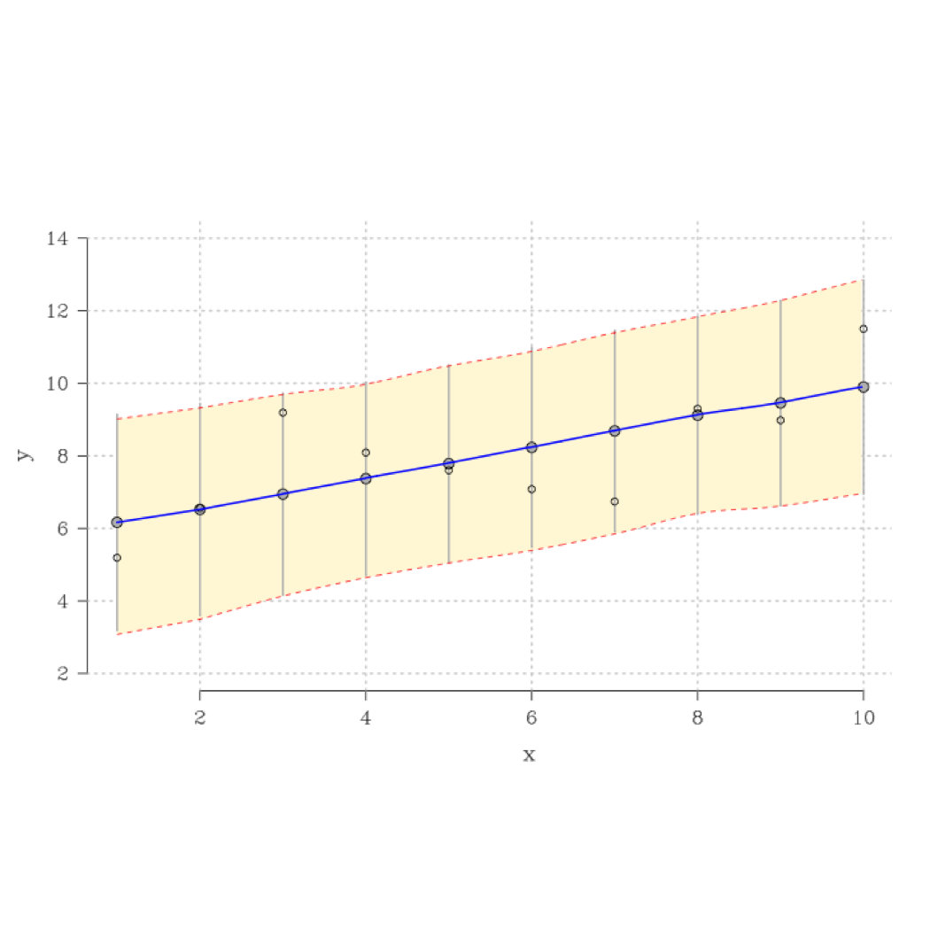
Bayesian Modeling Pipeline
Example 1: Bi-Variate Linear Model

Slide 2
Univariate Stats

Slide 3
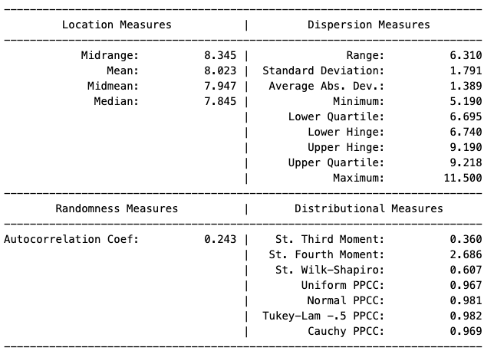
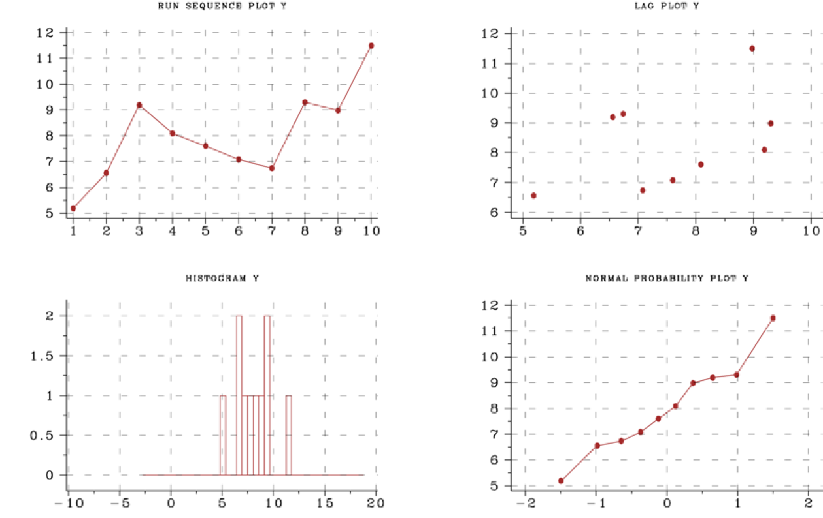
Outcome Variable: Y
The Levene Test applied to each quarter of the data indicates no heterogeneity in variances. Grubbs Test shows no outliers.
Levene Test Statistic: 0.33, p-value 0.8. Grubbs Test Statistic: 1.94, p-value 0.29
Notes:
Four assumptions typically underlie all measurement processes, namely that the data generated from the process are: 1) Random Draws from a 2) Fixed Distribution characterized by a 3) Fixed Location with 4) Fixed Variation.
The 4Chart provides a visual assessment of how closely the data in question meets these assumptions. The Run Sequence plot (the top-left panel) illustrates where there are shifts in either location and/or scale. It also highlight whether there are outliers. Shifts are indicated by trends in either the vertical or horizontal axes. If the data are random draws from an underlying distribution, then the draws should be a tight band, with noticeable spikes indicating outliers. The Lag Plot (top-right panel) tests if there is an underlying non-random structure to the data. A blob with a clear slope indicates moderate autocorrelation, a tight band strong autocorrelation or autoregression, and a circular pattern a sinusoidal (wave) structure. Assuming the data appear to have a fixed location, scale, and no underlying structure, it is important to assess if the data are drawn from a normal distribution or some other distribution with known properties. The Histogram (bottom-left) illustrates the distribution’s center, spread, skew, the presence of outliers, and the presence of modes. Finally, the Probability Plot (bottom-right) indicates to what extent the data resemble a given distribution with the default being a normal distribution. Observations are plotted as a function of the corresponding normal order statistic medians. Linearity indicates fit, with deviations indicating either short tails, fat tails, or skewness (for more information regarding these assumptions or interpreting the plot see: https://www.itl.nist.gov/div898/handbook/eda/section3/4plot.htm).
Most outlier tests assume normality, and all assume a fixed scale. Consequently, before formally tests for outliers, you need to first confirm whether the data has a fixed scale using a Levene test or some other test of equality of variance (for more information on both tests see: https://www.itl.nist.gov/div898/handbook/eda/section4/eda4244.htm).

Slide 4
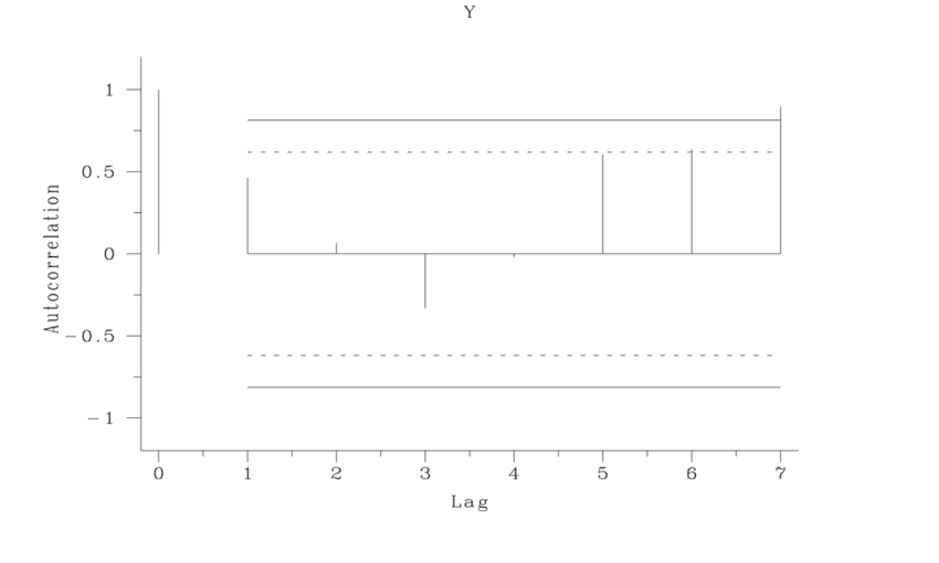
Y
Clear support for autocorrelation after checking for drift in location: Coefficient of 0.422, t-value of 2.88
https://www.itl.nist.gov/div898/handbook/eda/section4/eda4232.htm
Notes:
An autocorrelation plot checks the randomness of the data. This randomness is ascertained by computing autocorrelations for data values at varying time lags. If random, such autocorrelations should be near zero for any and all time-lag separations. If non-random, then one or more of the autocorrelations will be significantly non-zero. Note, an absence of autocorrelation is not a guarantee of randomness. They are other forms of non-randomness.
The vertical axis list a correlation coefficient (a value between -1 and 1); the horizontal axis = lag (an integer between 1 and n/4 where n is the number of observations). The middle line is at zero. The other four lines are 95 % and 99 % confidence bands (for more information see: https://www.itl.nist.gov/div898/handbook/eda/section3/autocopl.htm)

Slide 5
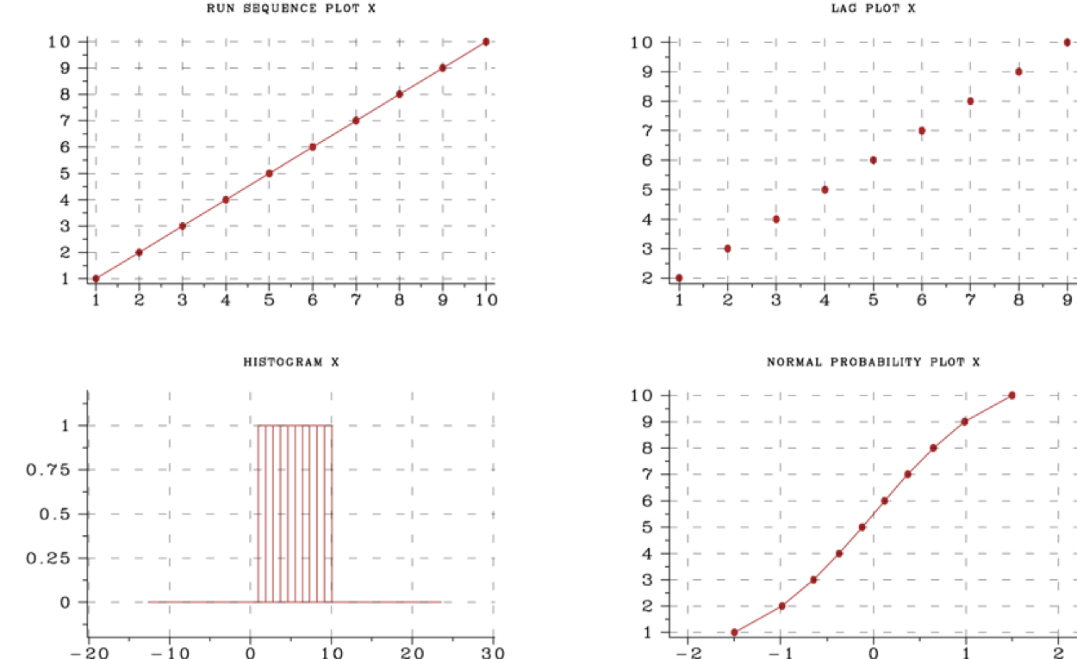
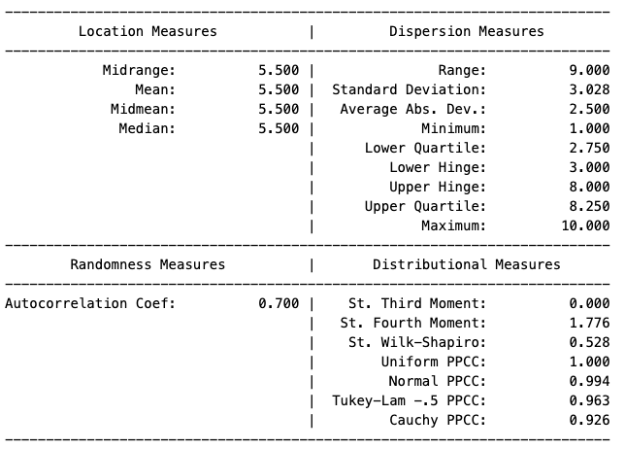
Explanatory Variable: X
The Levene Test applied to each quarter of the data indicates no support for heterogenous variances.
Levene Test Statistic: 0.1, p-value 0.95
Notes:
For a variety of distributions, alternative location, scale, dispersion, and distribution measures can be quite useful. I list the definitions of less common measures here.
Midrange: The sample midrange of a variable is the mean of the sample minimum and the sample maximum (i.e., (minimum + maximum)/2.).
Midmean: The midmean of a variable is the mean of the observations between the 25th and 75th percentiles. It is sometimes used instead of the mean because it is more resistant to outliers.
Average Absolute Deviation: The average absolute deviation (AAD) is defined as: ∑Ni=1(|Yi−Ȳ|)/N, where Ȳ is the mean of the data and |Y| is the absolute value of Y.
Lower Hinge: The median of the points between the minimum and the full sample median.
Upper Hinge: The median of the points between the median and the maximum point.
St. in the Table refers to standardized moments. A standardized moment of a probability distribution is a moment (normally a higher degree central moment) that is normalized. The normalization is typically a division by an expression of the standard deviation which renders the moment scale invariant. This has the advantage that such normalized moments differ only in other properties than variability, facilitating e.g. comparison of shape of different probability distributions.
PPCC refers to probability plot correlation coefficient. This is a flexible measure that can estimate how closely the observed distribution aligns with a known probability distribution, assuming the distribution does not require a shape parameter as well as a location and scale parameter. For more information regarding PPCC coefficients/plots, see: https://www.itl.nist.gov/div898/software/dataplot/refman1/auxillar/ppccplot.htm.

Slide 6
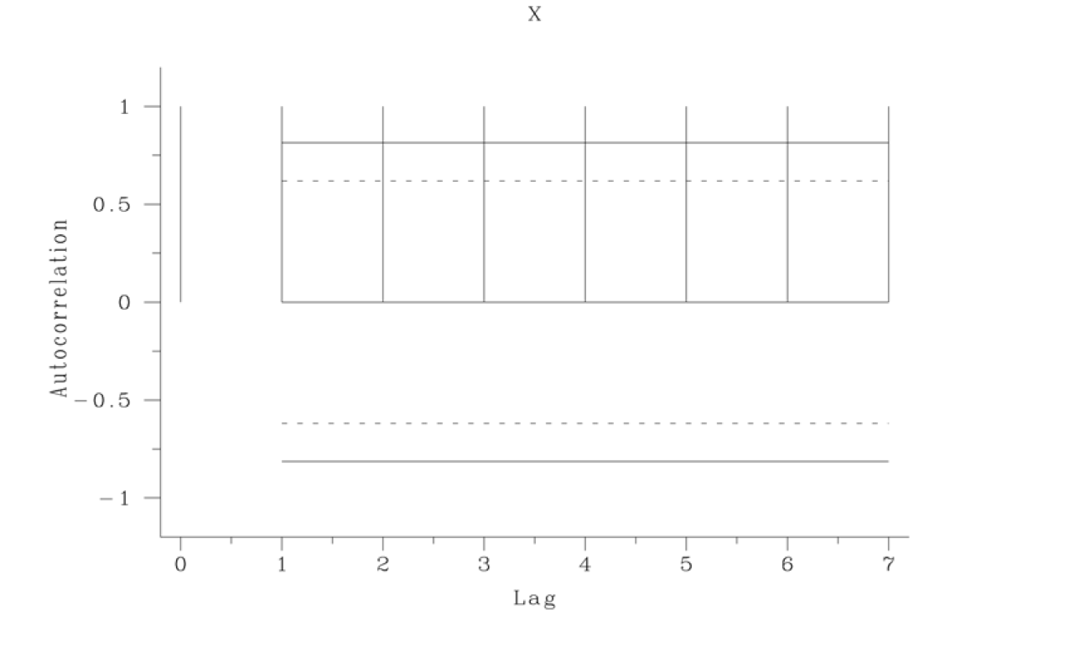
X
Clear support for autocorrelation after checking for drift in location: Coefficient of 1, t-value of 999
https://www.itl.nist.gov/div898/handbook/eda/section4/eda4232.htm

Slide 7
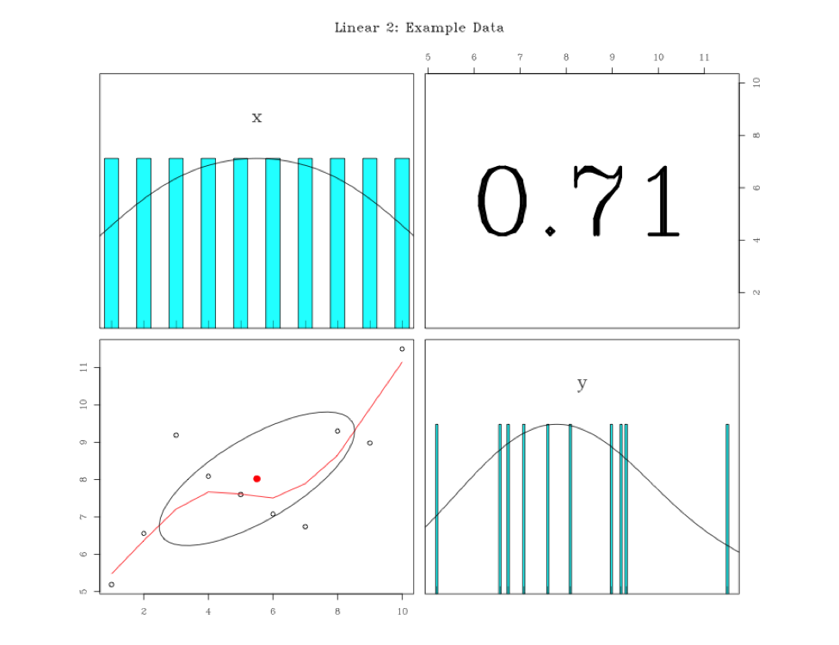
Pearson Correlations
Notes:
R’s psych’s pairs plot is a panel plot consisting of bivariate scatter plots below the diagonal, histograms on the diagonal, and the Pearson correlation above the diagonal. If lm=TRUE, linear regression fits are shown for both y by x and x by y. Correlation ellipses are also shown. Points may be given different colors depending upon some grouping variable. Robust fitting is done using lowess or loess regression. Confidence intervals of either the lm or loess are drawn if requested. In addition, the plot also supports Kendall and Spearman correlations (for more information see: https://cran.r-project.org/web/packages/psych/vignettes/intro.pdf).

Slide 8
Model

Slide 9
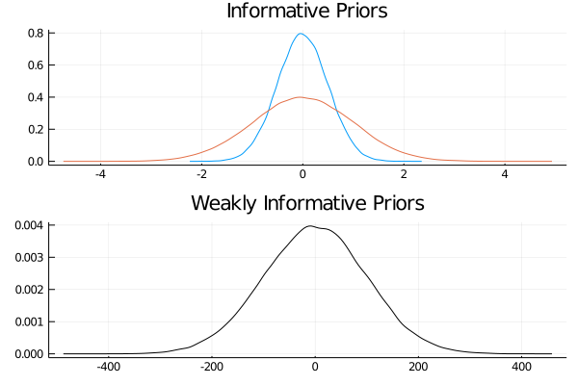
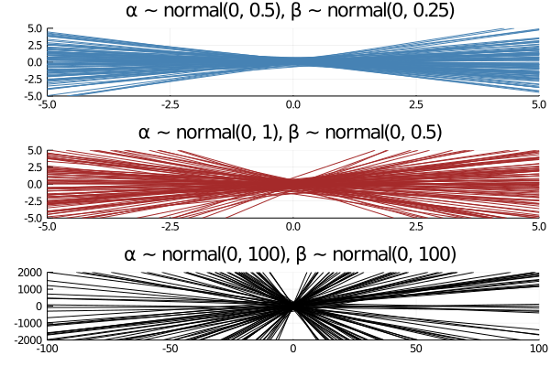
Prior Predicative Checks
Notes:
Prior elicitation is a crucial step in Bayesian modeling. Stan supports 7 families of priors: Student t family, Hierarchical shrinkage family, Laplace family, Product-normal family, Dirichlet family, Covariance matrices, and the R2 family. I will briefly describe each. For more information about priors in Stan, see: http://mc-stan.org/rstanarm/reference/priors.html. The plots above are meant to assist the analyst in both visualizing the prior, and its effect in conjunction with a given 𝛃 coefficient.
Student t family: For the prior distribution for the intercept, location, scale, and df should be scalars. For the prior for the other coefficients they can either be vectors of length equal to the number of coefficients (not including the intercept), or they can be scalars, in which case they will be recycled to the appropriate length.
Hierarchical Shrinkage family: The hierarchical shrinkage priors are normal with a mean of zero and a standard deviation that is also a random variable. The traditional hierarchical shrinkage prior utilizes a standard deviation that is distributed half Cauchy with a median of zero and a scale parameter that is also half Cauchy. This is called the "horseshoe prior". The hierarchical shrinkage (hs) prior in the rstanarm package instead utilizes a regularized horseshoe prior, as described by Piironen and Vehtari (2017), which recommends setting the global_scale argument equal to the ratio of the expected number of non-zero coefficients to the expected number of zero coefficients, divided by the square root of the number of observations.
The hierarchical shrinkage priors have very tall modes and very fat tails. Consequently, they tend to produce posterior distributions that are very concentrated near zero, unless the predictor has a strong influence on the outcome, in which case the prior has little influence. Using these priors often requires adjusting the adapt_delta parameter.
Laplace Family: The Laplace distribution is also known as the double-exponential distribution. It is a symmetric distribution with a sharp peak at its mean / median / mode and fairly long tails. This distribution can be motivated as a scale mixture of normal distributions and the remarks above about the normal distribution apply here as well.
The lasso approach to supervised learning can be expressed as finding the posterior mode when the likelihood is Gaussian and the priors on the coefficients have independent Laplace distributions. It is commonplace in supervised learning to choose the tuning parameter by cross-validation, whereas a more Bayesian approach would be to place a prior on “it”, or rather its reciprocal in our case (i.e. smaller values correspond to more shrinkage toward the prior location vector). We use a chi-square prior with degrees of freedom equal to that specified in the call to lasso or, by default, 1. The expectation of a chi-square random variable is equal to this degrees of freedom and the mode is equal to the degrees of freedom minus 2, if this difference is positive.
Product Normal Family: The product-normal distribution is the product of at least two independent normal variates each with mean zero, shifted by the location parameter. It can be shown that the density of a product-normal variate is symmetric and infinite at location, so this prior resembles a “spike-and-slab” prior for sufficiently large values of the scale parameter. For better or for worse, this prior may be appropriate when it is strongly believed (by someone) that a regression coefficient “is” equal to the location, parameter even though no true Bayesian would specify such a prior.
Each element of df must be an integer of at least 22 because these “degrees of freedom” are interpreted as the number of normal variates being multiplied and then shifted by location to yield the regression coefficient. Higher degrees of freedom produce a sharper spike at location. Each element of scale must be a non-negative real number that is interpreted as the standard deviation of the normal variates being multiplied and then shifted by location to yield the regression coefficient. In other words, the elements of scale may differ, but the k-th standard deviation is presumed to hold for all the normal deviates that are multiplied together and shifted by the k-th element of location to yield the k-th regression coefficient. The elements of scale are not the prior standard deviations of the regression coefficients. The prior variance of the regression coefficients is equal to the scale raised to the power of 22 times the corresponding element of df. Thus, larger values of scale put more prior volume on values of the regression coefficient that are far from zero.
Dirchlet Family: The Dirichlet distribution is a multivariate generalization of the beta distribution. It is perhaps the easiest prior distribution to specify because the concentration parameters can be interpreted as prior counts (although they need not be integers) of a multinomial random variable.
The Dirichlet distribution is used in stan_polr for an implicit prior on the cutpoints in an ordinal regression model. More specifically, the Dirichlet prior pertains to the prior probability of observing each category of the ordinal outcome when the predictors are at their sample means. Given these prior probabilities, it is straightforward to add them to form cumulative probabilities and then use an inverse CDF transformation of the cumulative probabilities to define the cutpoints.
Covariance Matrices: Covariance matrices are decomposed into correlation matrices and variances. The variances are in turn decomposed into the product of a simplex vector and the trace of the matrix. Finally, the trace is the product of the order of the matrix and the square of a scale parameter. This prior on a covariance matrix is represented by the decov function.
The prior for a correlation matrix is called LKJ whose density is proportional to the determinant of the correlation matrix raised to the power of a positive regularization parameter minus one. If regularization = 1 (the default), then this prior is jointly uniform over all correlation matrices of that size. If regularization > 1, then the identity matrix is the mode and in the unlikely case that regularization < 1, the identity matrix is the trough.
The trace of a covariance matrix is equal to the sum of the variances. We set the trace equal to the product of the order of the covariance matrix and the square of a positive scale parameter. The particular variances are set equal to the product of a simplex vector --- which is non-negative and sums to 11 --- and the scalar trace. In other words, each element of the simplex vector represents the proportion of the trace attributable to the corresponding variable.
A symmetric Dirichlet prior is used for the simplex vector, which has a single (positive) concentration parameter, which defaults to 11 and implies that the prior is jointly uniform over the space of simplex vectors of that size. If concentration > 1, then the prior mode corresponds to all variables having the same (proportion of total) variance, which can be used to ensure the the posterior variances are not zero. As the concentration parameter approaches infinity, this mode becomes more pronounced. In the unlikely case that concentration < 1, the variances are more polarized.
If all the variables were multiplied by a number, the trace of their covariance matrix would increase by that number squared. Thus, it is reasonable to use a scale-invariant prior distribution for the positive scale parameter, and in this case we utilize a Gamma distribution, whose shape and scale are both 11 by default, implying a unit-exponential distribution. Set the shape hyperparameter to some value greater than 11 to ensure that the posterior trace is not zero.
R2 Family: The stan_lm, stan_aov, and stan_polr functions allow the user to utilize a function called R2 to convey prior information about all the parameters. This prior hinges on prior beliefs about the location of 𝑅2R2, the proportion of variance in the outcome attributable to the predictors, which has a Beta prior with first shape hyperparameter equal to half the number of predictors and second shape hyperparameter free. By specifying what to be the prior mode (the default), mean, median, or expected log of 𝑅2, the second shape parameter for this Beta distribution is determined internally. If what = 'log', location should be a negative scalar; otherwise it should be a scalar on the (0,1) interval.
For example, if 𝑅2=0.5, then the mode, mean, and median of the Beta distribution are all the same and thus the second shape parameter is also equal to half the number of predictors. The second shape parameter of the Beta distribution is actually the same as the shape parameter in the LKJ prior for a correlation matrix described in the previous subsection. Thus, the smaller is 𝑅2, the larger is the shape parameter, the smaller are the prior correlations among the outcome and predictor variables, and the more concentrated near zero is the prior density for the regression coefficients. Hence, the prior on the coefficients is regularizing and should yield a posterior distribution with good out-of-sample predictions if the prior location of 𝑅2 is specified in a reasonable fashion.

Slide 10
Mathematical Description
Yi ~ N(ŷ, 𝝈)
Ŷi = 𝛂 + 𝛃𝐗𝑖
Prior Distributions
𝛂 ~ N(0, 100)
𝛃 ~ N(0, 100)
𝝈 ~ Half-Cauchy(0, 2)
Data
𝐗 = [1, 2, 3, 4, 5, 6, 7, 8, 9, 10]
Y = [5.19, 6.56, 9.19, 8.09, 7.6, 7.08, 6.74, 9.3, 8.98, 11.5]

Slide 11
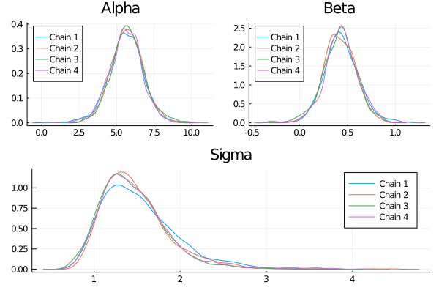
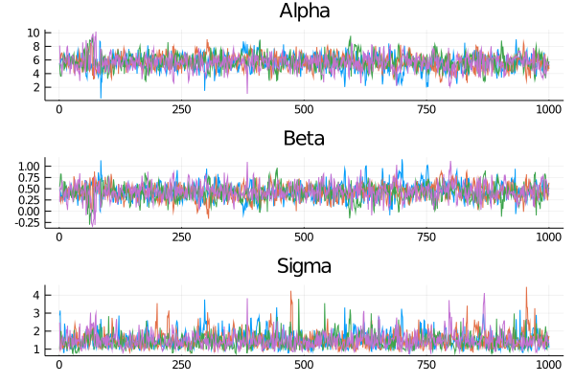
Parameter Inspection
Notes:
Because deriving an integral that summarizes the posterior distribution is approximated using MCMC sampling techniques, it is important to compare sampling chains to ensure that the sampling is consistent.
The Poster Density plots and MCMC Trace plots for each parameter provide an initial indicator of convergence. Overlapping posterior densities and caterpillar like traces suggest convergence while non-overlapping densities and distinct traces indicate a failure to converge.

Slide 12
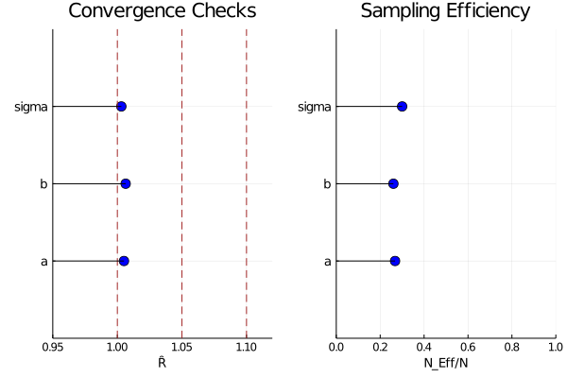
Model Diagnostics: Ȓ & Effective Sample Size
Notes:
Ȓ compares the between- and within-chain estimates for model parameters and other univariate quantities of interest. If chains have not mixed well (i.e., the between- and within-chain estimates don't agree), Ȓ values larger than 1 occurr. We recommend running at least four chains by default and only using the sample if R-hat is less than 1.05.
Another technical difficulty posed by MCMC methods is that the samples will typically be autocorrelated (or anticorrelated) within a chain. This increases the uncertainty of the estimation of posterior quantities of interest, such as means, variances, or quantiles, see Geyer (2011).
Stan estimates an effective sample size for each parameter, which plays the same role in the Markov chain Monte Carlo central limit theorem (MCMC CLT) as the number of independent draws plays in the standard central limit theorem (CLT).
To address the reduced efficiency resulting from the autocorrelation, Stan calculates the autocorrelation for all lags simultaneously using Eigen’s fast Fourier transform (FFT) package with appropriate padding, see Geyer (2011) for more detail on using FFT for autocorrelation calculations. To get a sense of the relative efficiency of the sampling, you can calculate the ratio of the effective sample to the full sample, with higher ratios indicating more efficient sampling.
References
Aki Vehtari, Andrew Gelman, Daniel Simpson, Bob Carpenter, and Paul-Christian Bürkner (2019). Rank-normalization, folding, and localization: An improved R-hat for assessing convergence of MCMC. arXiv preprint arXiv:1903.08008.
Geyer, Charles J. 2011. “Introduction to Markov Chain Monte Carlo.” In Handbook of Markov Chain Monte Carlo, edited by Steve Brooks, Andrew Gelman, Galin L. Jones, and Xiao-Li Meng, 3–48. Chapman; Hall/CRC.

Slide 13
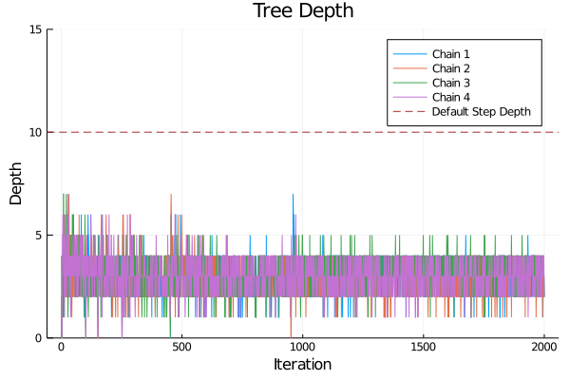
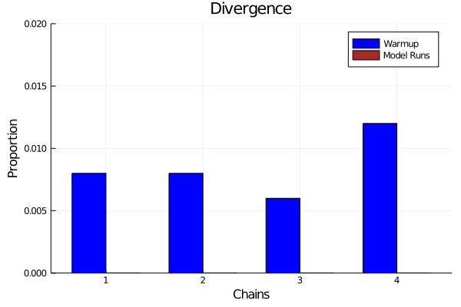
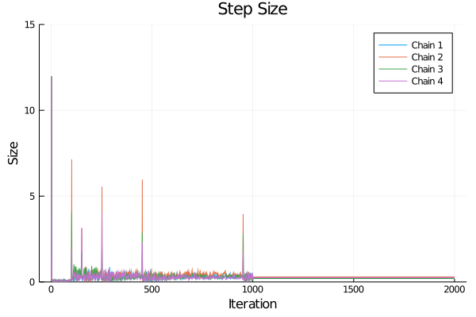
Model Diagnostics: Divergence, Tree Depth, & Step Size
Notes:
Divergence: Stan uses The Hamiltonian Monte Carlo algorithms (HMC and NUTS) to approximate the integral of the posterior distribution. Hamilton Monte Carlo simulates the trajectory of a fictitious particle representing parameter values when subject to a potential energy field, the value of which at a point is the negative log posterior density (up to a constant that does not depend on location).
Random momentum is imparted independently in each direction by drawing from a standard normal distribution. The Hamiltonian is defined to be the sum of the potential energy and kinetic energy of the system. The key feature of the Hamiltonian is that it is conserved along the trajectory the particle moves. Stan uses the leapfrog algorithm to simulate the path of a particle along the trajectory defined by the initial random momentum and the potential energy field. This is done by alternating updates of the position based on the momentum and the momentum based on the position. The momentum updates involve the potential energy and are applied along the gradient. This is essentially a stepwise (discretized) first-order approximation of the trajectory. Leimkuhler and Reich (2004) provide details and error analysis for the leapfrog algorithm.
A divergence arises when the simulated Hamiltonian trajectory departs from the true trajectory as measured by departure of the Hamiltonian value from its initial value. When this divergence is too high, the simulation has gone off the rails and cannot be trusted. The positions along the simulated trajectory after the Hamiltonian diverges will never be selected as the next draw of the MCMC algorithm, potentially reducing Hamiltonian Monte Carlo to a simple random walk and biasing estimates by not being able to thoroughly explore the posterior distribution. Betancourt (2016) provides details of the theory, computation, and practical implications of divergent transitions in Hamiltonian Monte Carlo.
Consequently, we want few divergences, and we want them to occur during warm-up. The left plot shows the proportion of divergences that occurred during each sampling phase: warm-up and modeling phases respectively.
Tree Depth: While divergent transitions are a validity concern, hitting the maximum treedepth is an efficiency concern. Configuring the No-U-Turn-Sampler (the variant of HMC used by Stan) involves putting a cap on the depth of the trees that it evaluates during each iteration (for details on this see the Hamiltonian Monte Carlo Sampling chapter in the Stan manual). This is controlled through a maximum depth parameter max_treedepth. When the maximum allowed tree depth is reached it indicates that NUTS is terminating prematurely to avoid excessively long execution time. In the Tree-Depth plot, the red-dash line indicates the default maximum tree-depth value. A health sampling process should be no where near this number.
Step Size: Stan explores the target distribution — the posterior defined by a Stan program + data — by simulating the evolution of a Hamiltonian system, as noted above. In order to approximate the exact solution of the Hamiltonian dynamics we need to choose a step size governing how far we move each time we evolve the system forward. That is, the step size controls the resolution of the sampler.
Unfortunately, for particularly hard problems there are features of the target distribution that are too small for this resolution. Consequently the sampler misses those features and returns biased estimates. Fortunately, this mismatch of scales manifests as divergences which provide a practical diagnostic.
For some intuition, imagine walking down a steep mountain. If you take too big of a step you will fall, but if you can take very tiny steps you might be able to make your way down the mountain, albeit very slowly. Similarly, we can tell Stan to take smaller steps around the posterior distribution, which (in some but not all cases) can help avoid these divergences.
A healthy sampling processes starts with larger steps to first roughly approximate the geometry of the distribution that become smaller as it comes to better approximate the distribution of interest. Consequently, we should see step size steadily decreases during warm-up and stay small during the modeling runs.

Slide 14
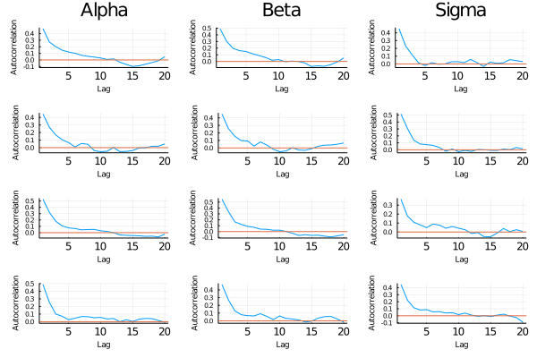
Model Diagnostics: MCMC Sample Autocorrelation
Notes:
The sampling autocorrelation plots provider as sense of not only the maximum level of autocorrelation but also how quickly it decreases as a function of distance.

Slide 15
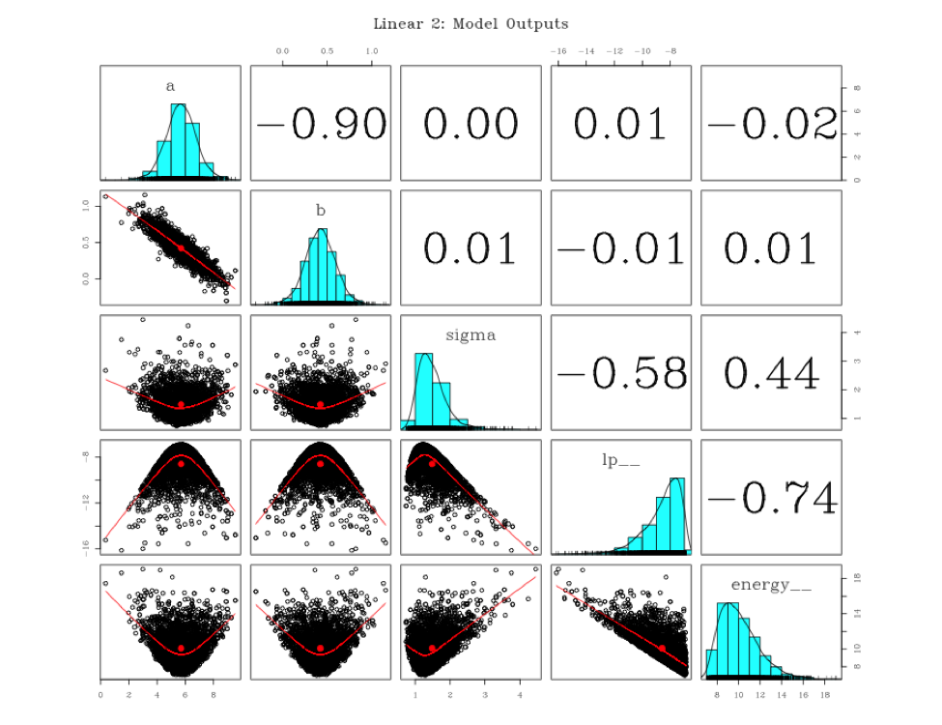
Model Diagnostics: Univariate & Bi-Variate Marginal Distributions
Notes:
lp__ refers to the kernel of the posterior density in log-units, possibly ignoring some or all constants.
energy__ refer to the value of the Hamiltonian Markov process (up to an additive constant) at each iteration.
The pairs plot is primarily used for accessing correlation between parameters.

Slide 16
Model Assessment

Slide 17
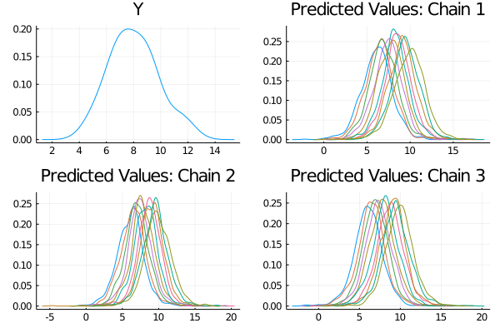
Posterior Predicative Checks
Notes:
The predicted distribution should approximate the outcome variable. The distribution should be at the same location and scale.

Slide 18
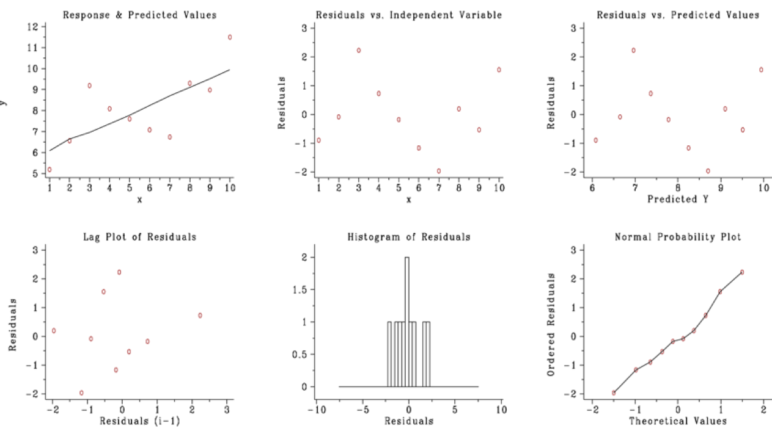
Posterior Predicative Checks
Residual SD: 1.26
Notes:
The 6-plot is a collection of 6 specific graphical techniques whose purpose is to assess the validity of a Y versus X fit. The 6-plot can be used to answer the following questions: 1) Are the residuals approximately normally distributed with a fixed location and scale? 2) Are there outliers? 3) Is the fit adequate? 4) Do the residuals suggest a better fit?
For a good model the fixed variation should be as small as possible. A necessary component of fitting models is to verify these assumptions for the error component and to assess whether the variation for the error component is sufficiently small. The histogram, lag plot, and normal probability plot are used to verify the fixed distribution, location, and variation assumptions on the error component. The plot of the response variable and the predicted values versus the independent variable is used to assess whether the variation is sufficiently small. The plots of the residuals versus the independent variable and the predicted values is used to assess the independence assumption.
In the multivariate case, the plot is broken into 3 plots: a panel plot displaying the fit and credibility interval of each explanatory variable holding the others explanatory variables constant at their mean, a plot displaying the residuals compared to each explanatory variable, and final panel plot showing the run sequence of the residuals and the relationships between the residuals and the predicted values.

Slide 19
Credible Interval
The credible interval does not span 0, indicating a statistically significant effect.
Notes:
To assess the magnitude and significance of the explanatory variable, we generate a credible interval. A credible interval is an interval within which an unobserved parameter value falls with a particular probability. In other words, the credible interval is just the range containing a particular percentage of probable values. For instance, the 95% credible interval is simply the central portion of the posterior distribution that contains 95% of the values.
In the figure, the band indicates the credible interval, the red dashed lines the 5th and 95th percentiles, the blue line median value, the grey fill points each median for each value of x, and the grey unfilled points the observed values.

Slide 20
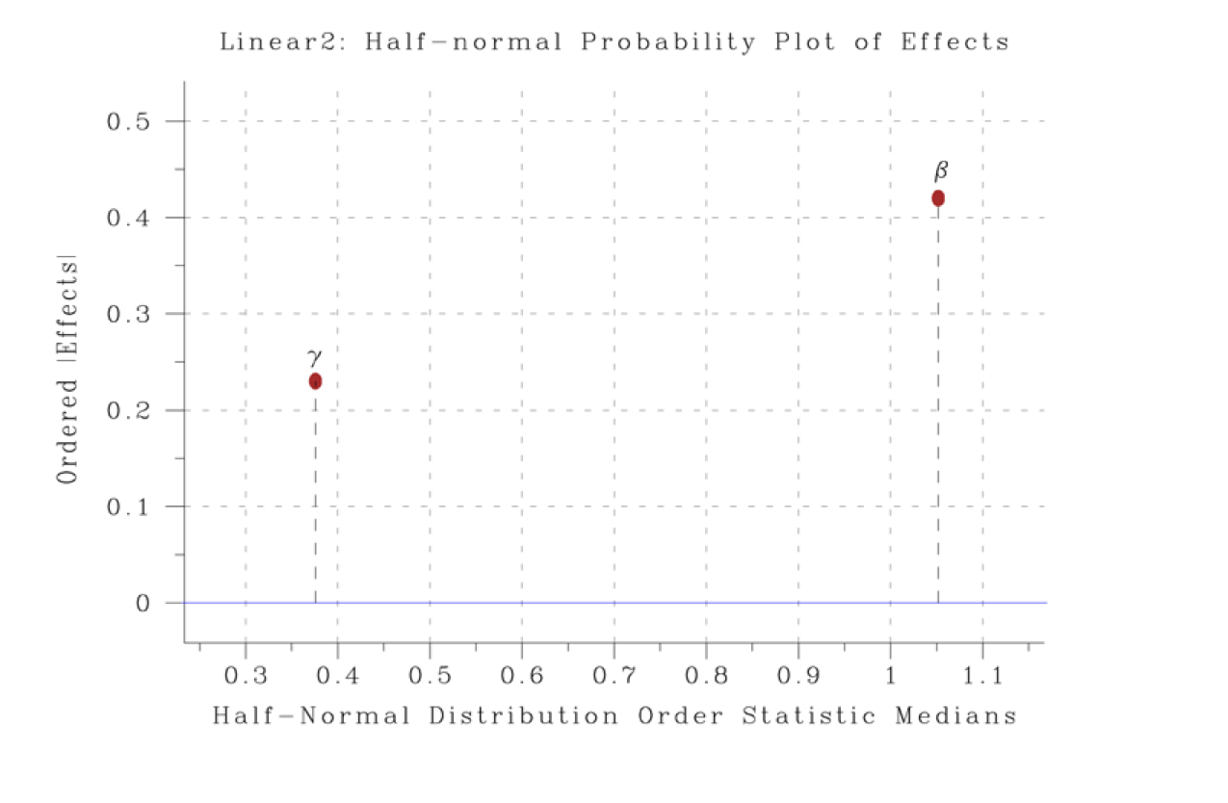
Thinking about Practical Significance
ŷ: 8.023
|𝛽i| > 𝜟
Engineering Standard: 10% of ŷ
0.0823
𝛄 included for demonstration purposes.
Notes:
A quick visual way to identify clusters of significant and non-significant coefficients is by plotting the effects with respect to a half-normal distribution. Weak effects will be near 0 and will follow a fairly clear linear pattern.
Under rather general conditions, the Central Limit Thereom allows that estimated effects tends to follow a normal distribution (for a large enough sample size n) a normal distribution. Plotting absolute effect estimates and their corresponding half‐normal scores provides a graphical display that compares the relative strength of various effects in the experiment.
By graphically displaying the relative magnitudes of the estimates, we can better assess if the effects are likely to be practically significant. Does a mean difference of 0.2 actually matter given what we know about the process?
In an ACT context, simulation is a good way to identify what scale of difference matters.
Vertical Axis: Ordered (largest to smallest) absolute value of the estimated effects for the main factors and available interactions. If n data points (no replication) have been collected, then typically (n-1) effects will be estimated and the (n-1) |effects| will be plotted.
Horizontal Axis: (n-1) theoretical order statistic medians from a half-normal distribution. These (n-1) values are not data-dependent. They depend only on the half-normal distribution and the number of items plotted (= n-1). The theoretical medians represent an "ideal" typical ordered data set that would have been obtained from a random drawing of (n-1) samples from a half-normal distribution.

Slide 21
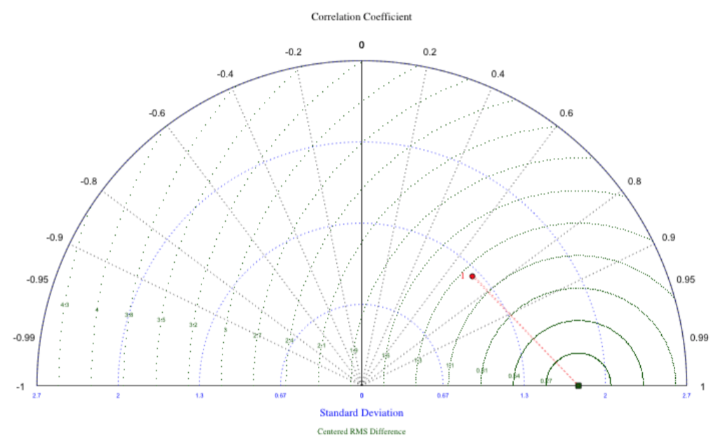
Comparing Simple and More Complex Models
Notes:
Model comparisons provide yet another validity check for the model. Taylor diagrams are an efficient way to assess across multiple dimensions of error the performance of simple and more complex models. In general, the Taylor diagram characterizes the statistical relationship between two fields, a "test" field (often representing a field simulated by a model) and a "reference" field (usually representing “truth”, based on observations). Note that the means of the fields are subtracted out before computing their second-order statistics, so the diagram does not provide information about overall biases, but solely characterizes the centered pattern error. The similarity between model predictions and the y is quantified in terms of their correlation, their centered root-mean-square difference and the amplitude of their variations (represented by their standard deviations).
Larger distances away from the observed values, the green block, indicates poor fits. The arcs indicate in what ways the model predictions are accurately or inaccurately approximating the outcome variable.
For each model displayed in a Taylor Diagram, three statistics are plotted: the Pearson correlation coefficient (gauging similarity in the pattern between the simulated and observed fields) is related to the azimuthal angle (black contours); the centered RMS error in the simulated field is proportional to the distance from the point on the x-axis identified as “observed” (green contours); and the standard deviation of the simulated pattern is proportional to the radial distance from the origin (blue contours). It is evident from this diagram, for example, that Linear2’s the correlation coefficient is about 0.7, the RMS error is about 1.25 units and the standard deviation is about 1.3. Linear2’s is clearly struggling to approximate the y’s variance reflected in both the poor STD resulting in RMS differences.
When comparing models, include the Residual SD of each Model as a table or in text.

